Slide 1
Results of the experiment in the Moscow Regional Research & Scientific Clinical Institute named after M.F. Vladimirsky (MONIKI)
ACTION OF DEVICES
Study of blood serum structures of patients in the clinical units of a hospital under the exposure to various modes of the devices DeVita AP Base, DeVita Ritm Base, DeVita Energy in vitro.

Slide 2
ACTION OF DEVICES
Experimental conditions:
For the purposes of the study, 20 samples of blood serum of patients of therapeutic, endocrinological, pediatric, dermatovenereological and gastroenterological units of the multidisciplinary scientific and clinical institute of Moscow were taken.
The blood serum was separated into 6 tubes of 100 μl each:
After exposure, the structures of blood serum were obtained by the method of wedge dehydration and systemic and local organization was assessed immediately after exposure and 24 hours after exposure.
0 – control (without exposure);
1 – general mode;
2 – "Blood Circulation" mode;
3 – "Detoxification" mode;
4 – "Lymph Detox" mode;
5 – "Energy" mode.

Slide 3
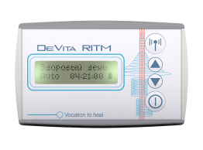
DEVITA RITM "BLOOD CIRCULATION"
Mode 2
CONTROL (n = 20)
(main markers in blood serum facies before exposure)
MARKER | MANIFESTATION DEGREE OF MORPHOLOGICAL MARKER
 | Absence (0) | Weak (+) | Moderate (++) | High (+++)
Chronic intoxication | 1 | 3 | 10 | 6
Manifestation of protective reaction of organism in the form of inflammation marker | 12 | 6 | 1 | 1
Microcirculation activity of blood channel | 17 | 1 | 2 | 0
MARKER | MANIFESTATION DEGREE OF MORPHOLOGICAL MARKER IMMEDIATELY AFTER EXPOSURE
 | (0) * | (+) | (++) | (+++)
Chronic intoxication | 5 (0)* | 3 (0)* | 3 (2*) | 9 (2)*
Manifestation of protective reaction in the form of inflammation marker | 17(10)* | 3 (1)* | 0 | 0
Microcirculation activity of blood channel | 13 (11)* | 7 (0)* | 0 | 0
MANIFESTATION DEGREE OF MORPHOLOGICAL MARKER 24 HOURS AFTER EXPOSURE
(0)* | (+) | (++) | (+++)
12 (0)* | 6 (0)* | 2 (2)* | 0
8 (6)* | 8 (4)* | 2 (0)* | 2 (0)*
7 (6)* | 8 (0)* | 3 (0)* | 2 (0)*
* without changes compared to control from overall number of samples

Slide 4
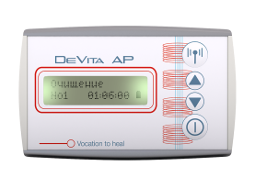
DEVITA AP "LYMPH DETOX"
Mode 4
CONTROL (n = 20)
(main markers in blood serum facies before exposure)
MARKER | MANIFESTATION DEGREE OF MORPHOLOGICAL MARKER
 | Absence (0) | Weak (+) | Moderate (++) | High (+++)
Chronic intoxication | 1 | 3 | 10 | 6
Manifestation of protective reaction of organism in the form of inflammation marker | 12 | 6 | 1 | 1
Microcirculation activity of blood channel | 17 | 1 | 2 | 0
MARKER | MANIFESTATION DEGREE OF MORPHOLOGICAL MARKER IMMEDIATELY AFTER EXPOSURE
 | (0) * | (+) | (++) | (+++)
Chronic intoxication | 5 (0)* | 3 (0)* | 3 (2*) | 9 (2)*
Manifestation of protective reaction in the form of inflammation marker | 17(10)* | 3 (1)* | 0 | 0
Microcirculation activity of blood channel | 13 (11)* | 7 (0)* | 0 | 0
MANIFESTATION DEGREE OF MORPHOLOGICAL MARKER 24 HOURS AFTER EXPOSURE
(0)* | (+) | (++) | (+++)
12 (0)* | 6 (0)* | 2 (2)* | 0
8 (6)* | 8 (4)* | 2 (0)* | 2 (0)*
7 (6)* | 8 (0)* | 3 (0)* | 2 (0)*
* without changes compared to control from overall number of samples

Slide 5
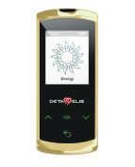
DEVITA ENERGY "ENERGY"
Mode 5
CONTROL (n = 20)
(main markers in blood serum facies before exposure)
MARKER | MANIFESTATION DEGREE OF MORPHOLOGICAL MARKER
 | Absence (0) | Weak (+) | Moderate (++) | High (+++)
Chronic intoxication | 1 | 3 | 10 | 6
Manifestation of protective reaction of organism in the form of inflammation marker | 12 | 6 | 1 | 1
Microcirculation activity of blood channel | 17 | 1 | 2 | 0
MARKER | MANIFESTATION DEGREE OF MORPHOLOGICAL MARKER IMMEDIATELY AFTER EXPOSURE
 | (0)* | (+) | (++) | (+++)
chronic intoxication | 10 (1)* | 7 (1)* | 2 (1)* | 1 (0)*
Manifestation of protective reaction in the form of inflammation marker | 8 (5)* | 10 (2)* | 2 (0)* | 0
Microcirculation activity of blood channel | 16 (6)* | 11 (0)* | 3 (0)* | 0
MANIFESTATION DEGREE OF MORPHOLOGICAL MARKER 24 HOURS AFTER EXPOSURE
(0)* | (+) | (++) | (+++)
11 (1)* | 5 (2)* | 4 (2)* | 0
1 (0)* | 4 (1)* | 10 (2)* | 5 (0)*
1 (1)* | 4 (0)* | 10 (1)* | 5 (0)*
* without changes compared to control from overall number of samples

Slide 6
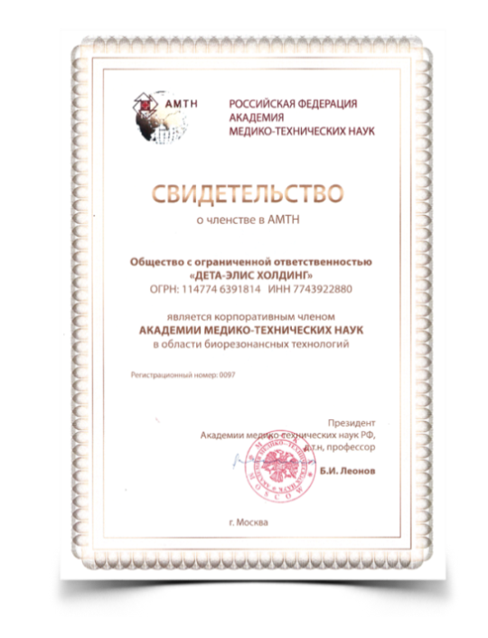
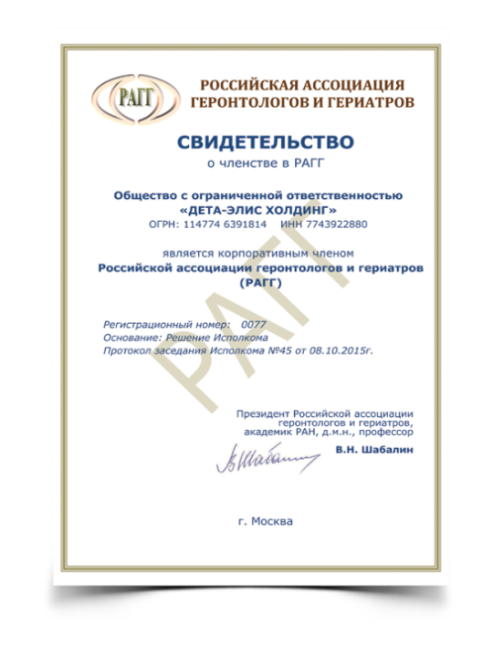
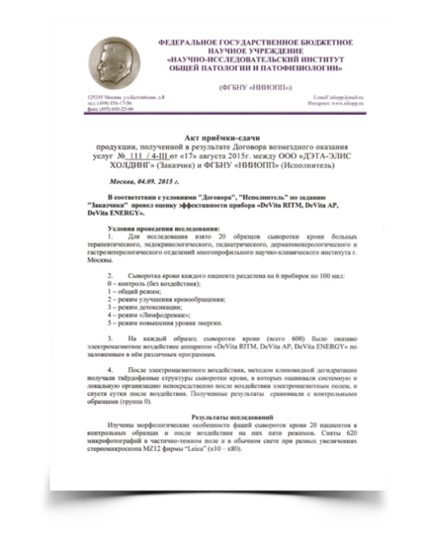
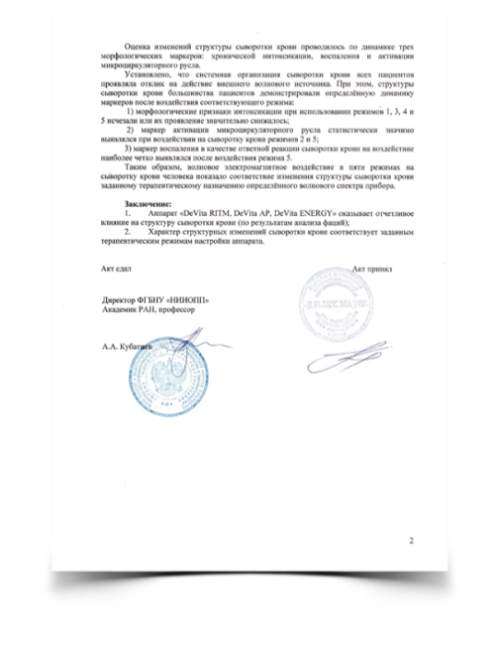
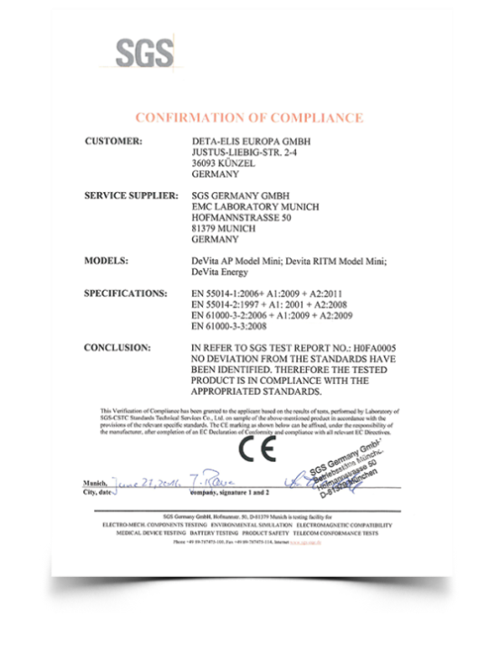
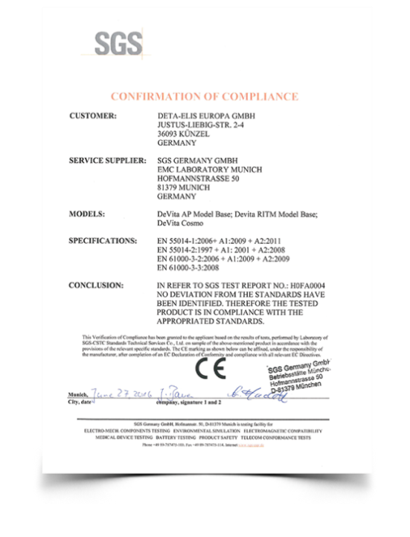
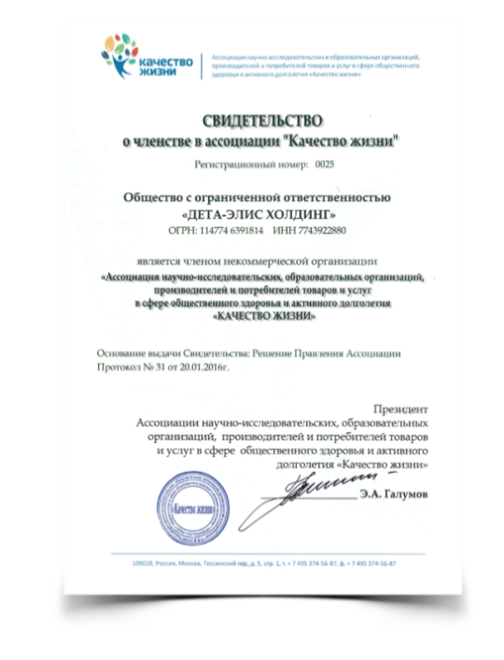
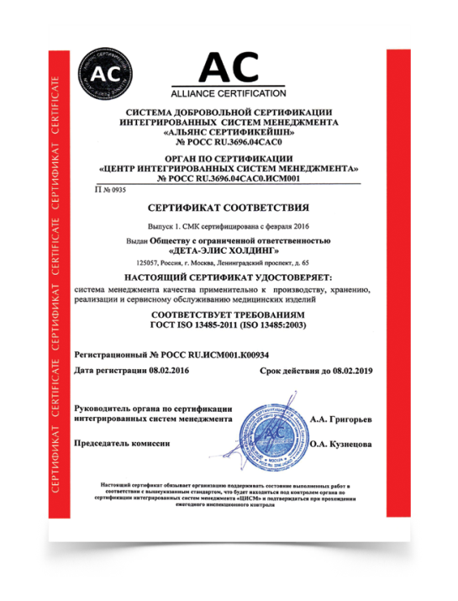
CERTIFICATES AND PERMITS

